Slide 1
Introduction to Clustering
Unsupervised Learning

Slide 2
Outline
Basic concepts
  Intro to clustering
  Examples of clustering
K-means algorithm
  A centroid-based iterative algorithm
K-means example
Strengths and weaknesses of K-means
Summary
CS583, Bing Liu, UIC

Slide 3
Supervised learning vs. unsupervised learning
Supervised learning: discover patterns in the data that relate data attributes with a target (class) attribute.
  These patterns are then utilized to predict the values of the target attribute in future data instances.
Unsupervised learning: The data have no target attribute.
  We want to explore the data to find some intrinsic structures in them.
CS583, Bing Liu, UIC

Slide 4
Clustering
Clustering is a technique for finding similarity groups in data, called clusters. I.e.,
  it groups data instances that are similar to (near) each other in one cluster and data instances that are very different (far away) from each other into different clusters.
Clustering is often called an unsupervised learning task as no class values denoting an a priori grouping of the data instances are given, which is the case in supervised learning.
Due to historical reasons, clustering is often considered synonymous with unsupervised learning.
CS583, Bing Liu, UIC

Slide 5
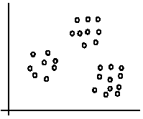
An illustration
The data set has three natural groups of data points, i.e., 3 natural clusters.
CS583, Bing Liu, UIC

Slide 6
What is clustering for?
Let us see some real-life examples
Example 1: groups people of similar sizes together to make “small”, “medium” and “large” T-Shirts.
  Tailor-made for each person: too expensive
  One-size-fits-all: does not fit all.
Example 2: In marketing, segment customers according to their similarities
  To do targeted marketing.
CS583, Bing Liu, UIC

Slide 7
What is clustering for? (cont…)
Example 3: Given a collection of text documents, we want to organize them according to their content similarities,
  To produce a topic hierarchy
CS583, Bing Liu, UIC

Slide 8
Aspects of clustering
A clustering algorithm
  Partitional clustering: divide example into different distinct partition
  Hierarchical clustering
  …
A distance (similarity, or dissimilarity) function
Clustering quality
  Inter-clusters distance ⇒ maximized
  Intra-clusters distance ⇒ minimized
The quality of a clustering result depends on the algorithm, the distance function, and the application.
CS583, Bing Liu, UIC

Slide 9
Road map
Basic concepts
K-means algorithm
Representation of clusters
Hierarchical clustering
Distance functions
Data standardization
Handling mixed attributes
Which clustering algorithm to use?
Cluster evaluation
Discovering holes and data regions
Summary
CS583, Bing Liu, UIC

Slide 10
K-means clustering
K-means is a partitional clustering algorithm
Let the set of data points (or instances) D be
{x₁, x₂, …, x_{n}},
  where x_{i} = (x_{i1}, x_{i2}, …, x_{ir}) is a vector in a real-valued space X ⊆ R^{r}, and r is the number of attributes (dimensions) in the data.
The k-means algorithm partitions the given data into k clusters.
  Each cluster has a cluster center, called centroid.
  k is specified by the user
CS583, Bing Liu, UIC

Slide 11
K-means algorithm
Given k, the k-means algorithm works as follows:
  Randomly choose k data points (seeds) to be the initial centroids, cluster centers
  Assign each data point to the closest centroid
  Re-compute the centroids using the current cluster memberships.
  If a convergence criterion is not met, go to 2).
CS583, Bing Liu, UIC

Slide 12
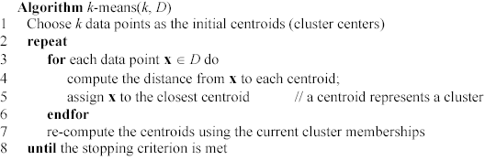
K-means algorithm – (cont …)
CS583, Bing Liu, UIC

Slide 13
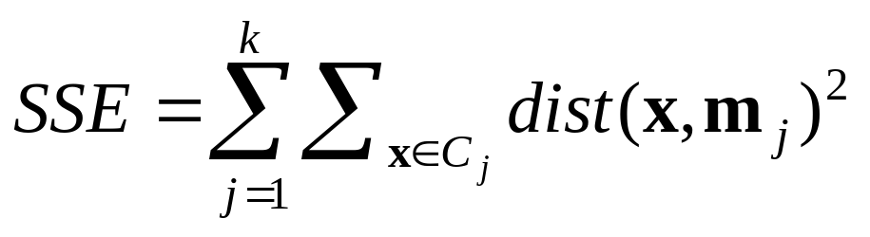
Stopping/convergence criterion
no (or minimum) re-assignments of data points to different clusters,
no (or minimum) change of centroids, or
minimum decrease in the sum of squared error (SSE),
  C_{j} is the jth cluster, m_{j} is the centroid of cluster C_{j} (the mean vector of all the data points in C_{j}), and dist(x, m_{j}) is the distance between data point x and centroid m_{j}.
(1)
CS583, Bing Liu, UIC

Slide 14
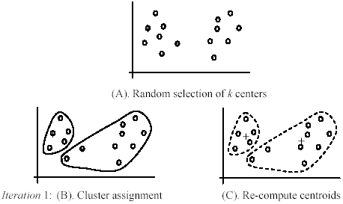
An example
+
+
CS583, Bing Liu, UIC

Slide 15
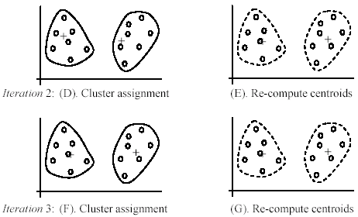
An example (cont …)
CS583, Bing Liu, UIC

Slide 16
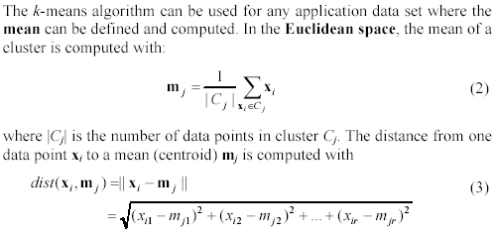
An example distance function
CS583, Bing Liu, UIC

Slide 17
Home Work
Instance | X | Y
 | 2 | 2
2. | 4 | 2
3. | 8 | 4
4. | 12 | 2
5. | 12 | 6
6. | 12 | 10

Slide 18
Strengths of k-means
Strengths:
  Simple: easy to understand and to implement
  Efficient: Time complexity: O(tkn),
  where n is the number of data points,
  k is the number of clusters, and
  t is the number of iterations.
  Since both k and t are small. k-means is considered a linear algorithm.
K-means is the most popular clustering algorithm.
CS583, Bing Liu, UIC

Slide 19
Weaknesses of k-means
The algorithm is only applicable if the mean is defined.
  For categorical data, k-mode - the centroid is represented by most frequent values.
The user needs to specify k.
The algorithm is sensitive to outliers
  Outliers are data points that are very far away from other data points.
  Outliers could be errors in the data recording or some special data points with very different values.
CS583, Bing Liu, UIC

Slide 20
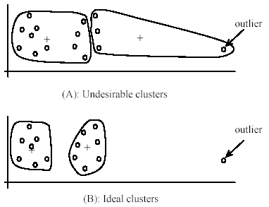
Weaknesses of k-means: Problems with outliers
CS583, Bing Liu, UIC

Slide 21
Weaknesses of k-means: To deal with outliers
One method is to remove some data points in the clustering process that are much further away from the centroids than other data points.
Another method is to perform random sampling. Since in sampling we only choose a small subset of the data points, the chance of selecting an outlier is very small.
CS583, Bing Liu, UIC

Slide 22
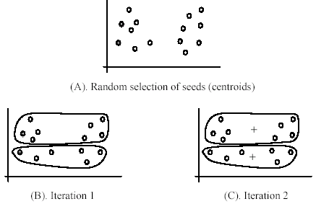
Weaknesses of k-means (cont …)
The algorithm is sensitive to initial seeds.
CS583, Bing Liu, UIC

Slide 23
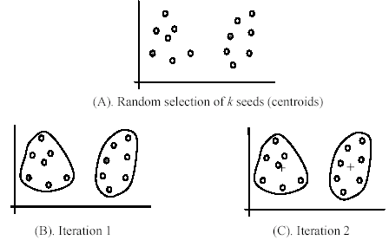
Weaknesses of k-means (cont …)
If we use different seeds: good results
There are some methods to help choose good seeds, such as k-means++
CS583, Bing Liu, UIC

Slide 24
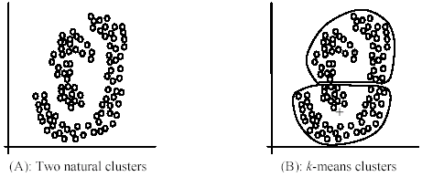
Weaknesses of k-means (cont …)
The k-means algorithm is not suitable for discovering clusters that are not hyper-ellipsoids (or hyper-spheres).
+
CS583, Bing Liu, UIC

Slide 25
K-means summary
Despite weaknesses, k-means is still the most popular algorithm due to its simplicity, efficiency and
  other clustering algorithms have their own lists of weaknesses.
No clear evidence that any other clustering algorithm performs better in general
  although they may be more suitable for some specific types of data or applications.
Comparing different clustering algorithms is a difficult task. No one knows the correct clusters!
CS583, Bing Liu, UIC

Slide 26
K-means Clustering – Example

Slide 27

A Simple example showing the implementation of k-means algorithm (using K=2)

Slide 28


Step 1:
Initialization: Randomly we choose following two centroids (k=2) for two clusters.
In this case the 2 centroid are: m1=(1.0,1.0) and m2=(5.0,7.0).

Slide 29
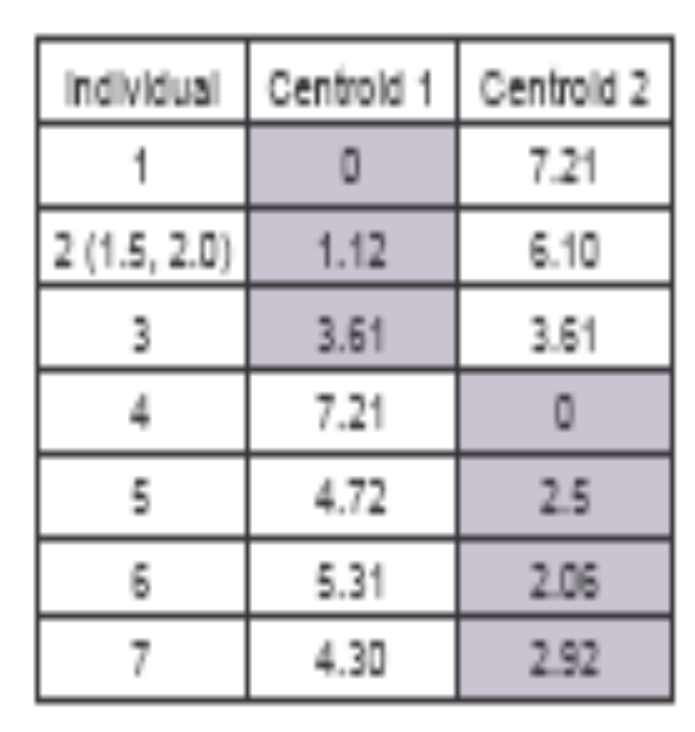




Step 2:
Thus, we obtain two clusters containing:
{1,2,3} and {4,5,6,7}.
Their new centroids are:

Slide 30

Step 3:
Now using these centroids we compute the Euclidean distance of each object, as shown in table.
Therefore, the new clusters are:
{1,2} and {3,4,5,6,7}
Next centroids are: m1=(1.25,1.5) and m2 = (3.9,5.1)

Slide 31

Step 4 :
The clusters obtained are:
{1,2} and {3,4,5,6,7}
Therefore, there is no change in the cluster.
Thus, the algorithm comes to a halt here and final result consist of 2 clusters {1,2} and {3,4,5,6,7}.

Slide 32

PLOT

